Slide 1
DATABASE DIRECTIONS
The overall goal of this project is to determine whether select characteristics, listed in the database, appear or not in the handwriting specimens. You do not need to concern yourself with how often a characteristic appears – just whether it appears at all or does not appear.
Here is how it is done.

Slide 2

When you open the database you will find a yellow band that starts Security Warning. Click on the prompt that says Enable Content (See Arrow).

Slide 3

The database is split into cursive and printed characters. The database is quite large and may require some time to load (might see “not responding” at top of page – just ignore it and wait. Click on “Cursive” prompt to begin entering data.

Slide 4
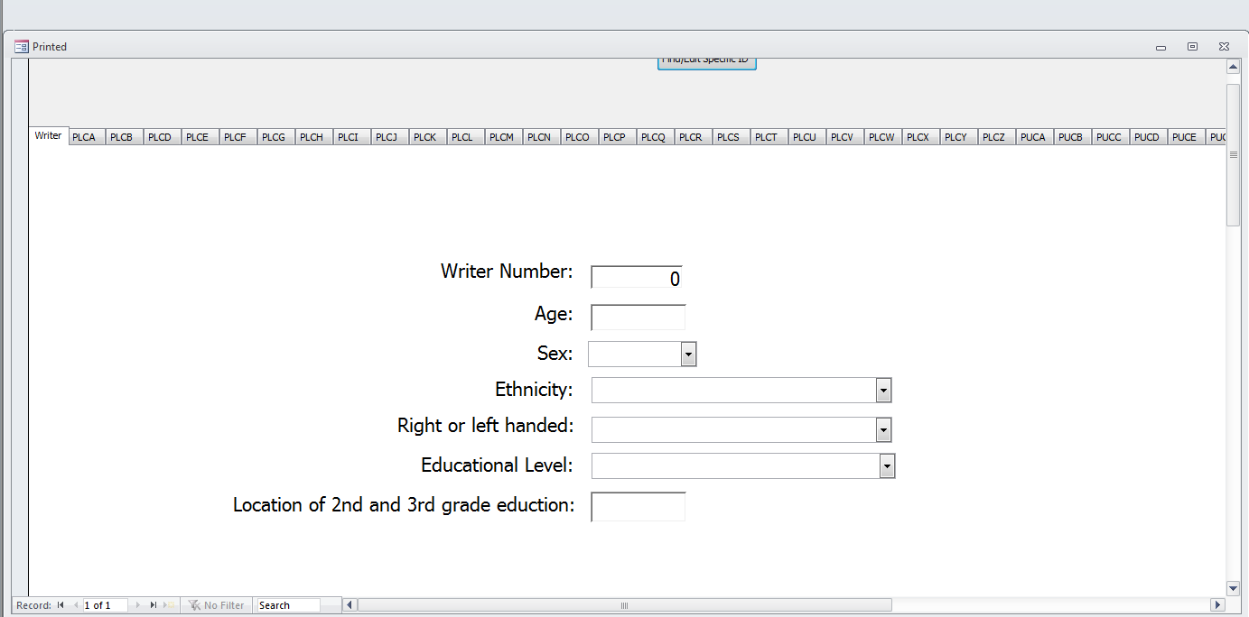
owever
This screen was for use in data collection. You do not need to use this screen. Continue to the next slide.

Slide 5
There are a series of tabs at the top of the screen as noted by the arrow. PLCA is for Printed Lower Case A, PLCB is for Printed Lower Case B, etc. Click on the letter for entry. Be careful to fill in all pages. Not all characters are represented as some characters had no features that passed the pilot assessment.

Slide 6
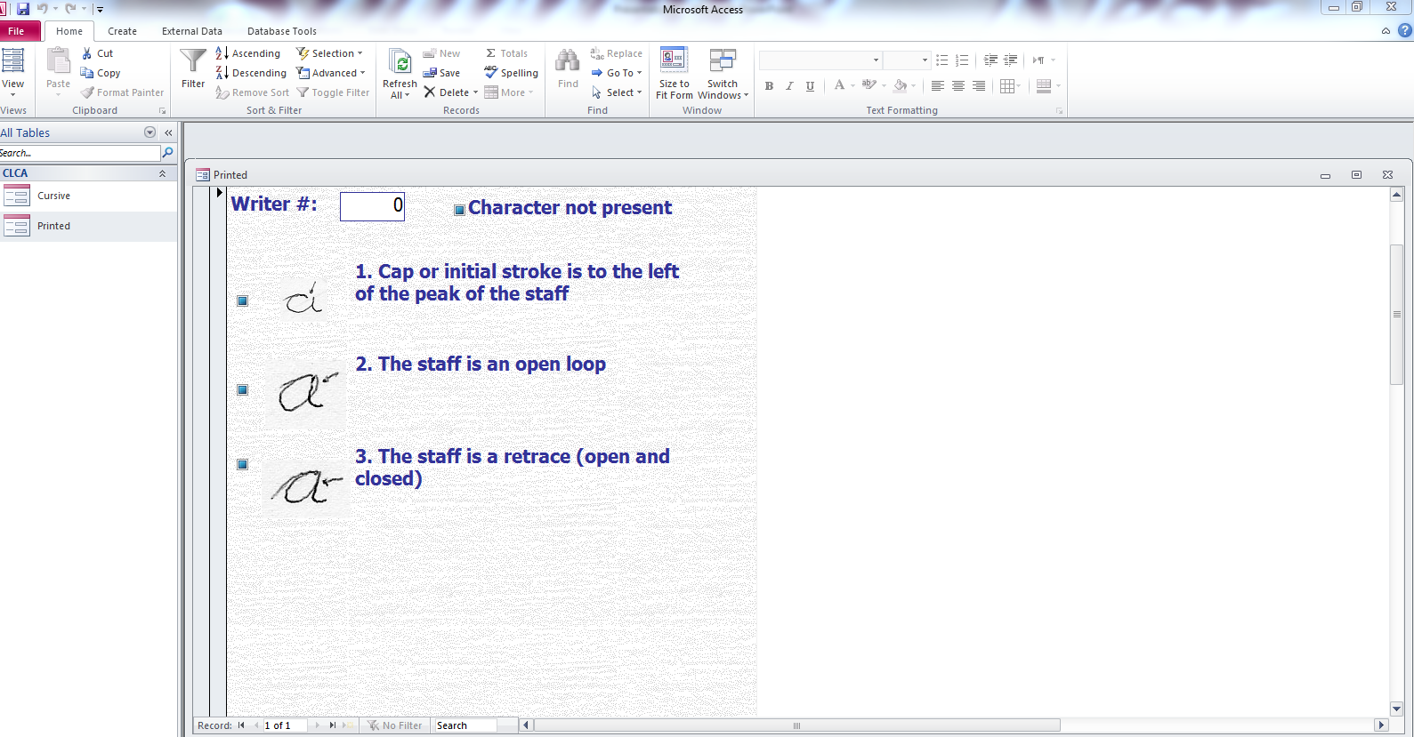
Upon prompting the tab for a character the features will be listed as above.

Slide 7
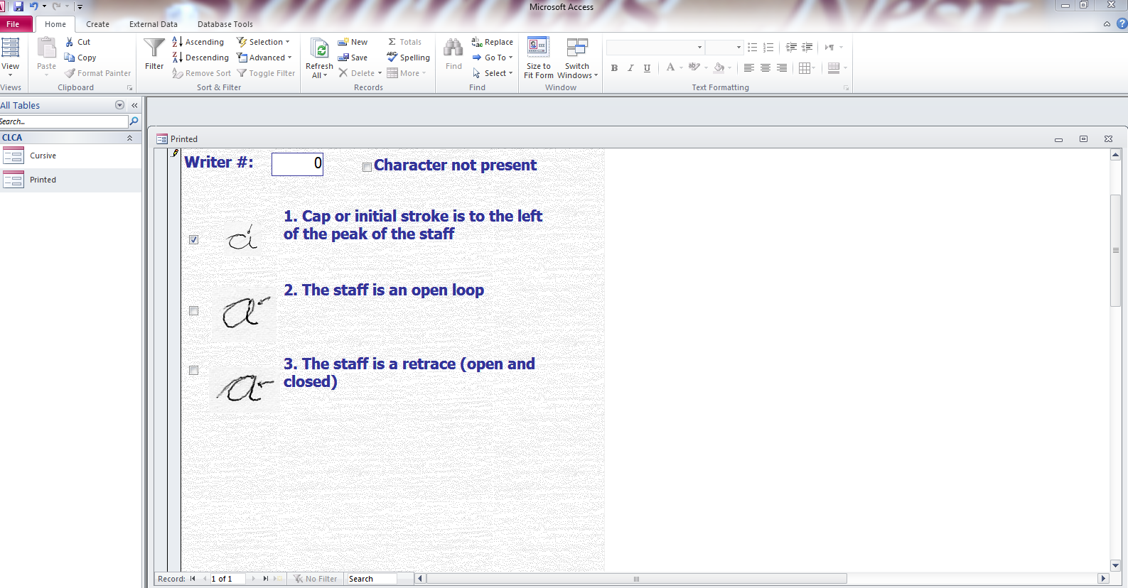
1
2
When you review the features of a specific character you will note that the tabs at the top disappear (Arrow 1). To make them reappear, slide the bar (Arrow 2) up to the top.

Slide 8
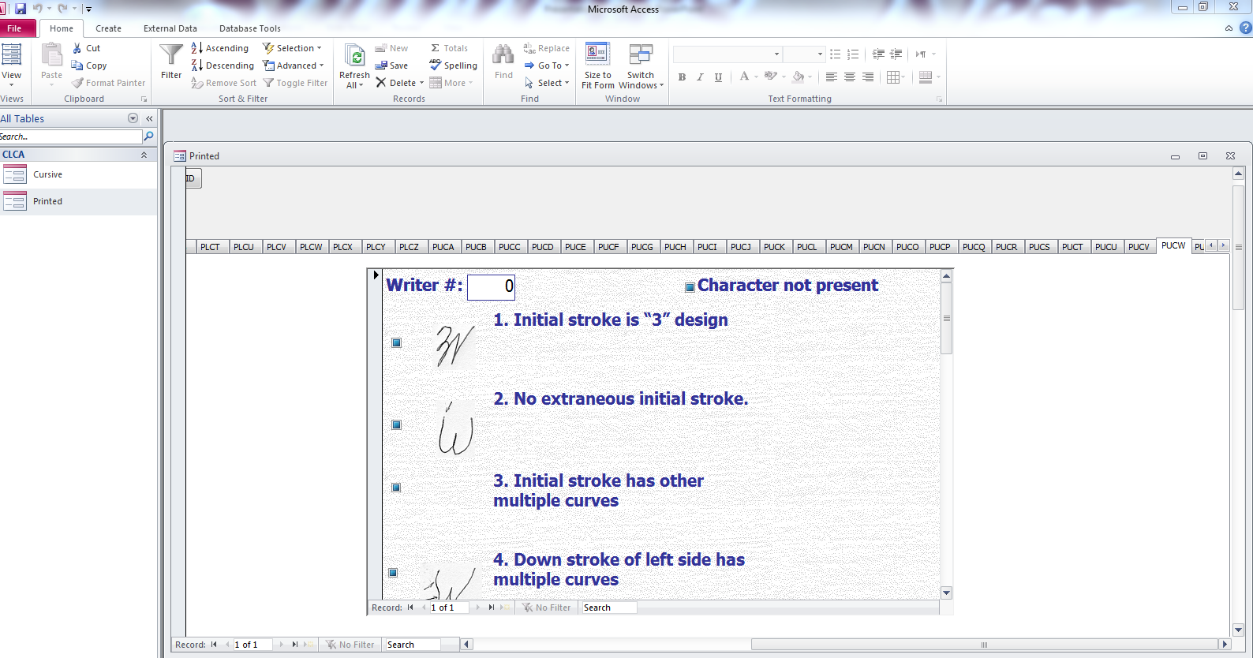
u
2
1
As you proceed though each of the characters you can move the tabs by moving the bar at the bottom to the right (Arrow 1). Once it reaches the right end you will notice a set of arrows (Arrow 2). You can use these tools in any tandem to access all characters

Slide 9
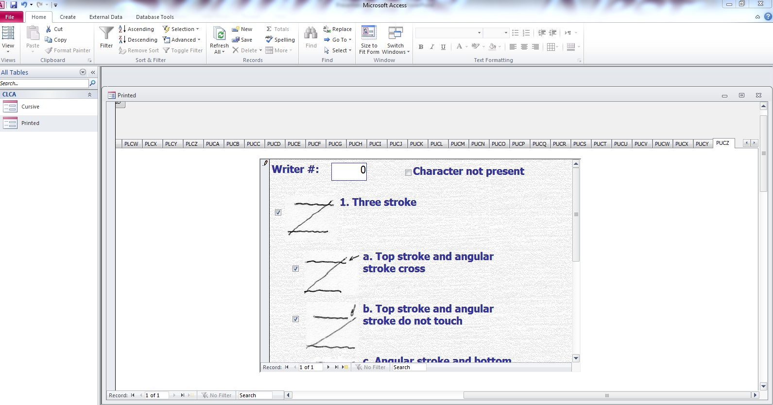
When you complete the entire form (cursive or printed), click on the X as per the arrow above to close that file. Failure to do so before attempting to open the other file will overload your system.

